Slide 1
Where do you live?
Unit 9
Lesson 1

Slide 2
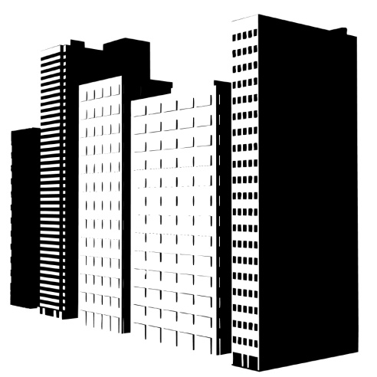
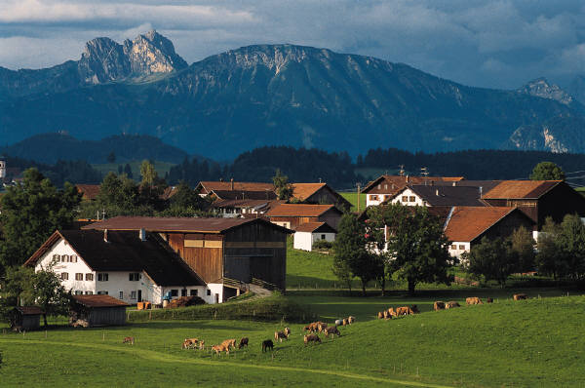
Where do you live?
city
town
village
I live in a … .

Slide 3
Ex. 3 p. 89
. | . . | . . | . . .
bank shop park zoo bus bridge | office market theatre station river | hotel police | library hospital cinema

Slide 4
There is/ there are
There is a bank in the city.
There’s a bank in the city.
There are two banks in the city.
There’re two banks in the city.

Slide 5
There was/ there were
There was a park in the city.
Was there a park in the city?- Yes, there was.
No, there wasn’t.
Where was it?

