Slide 1
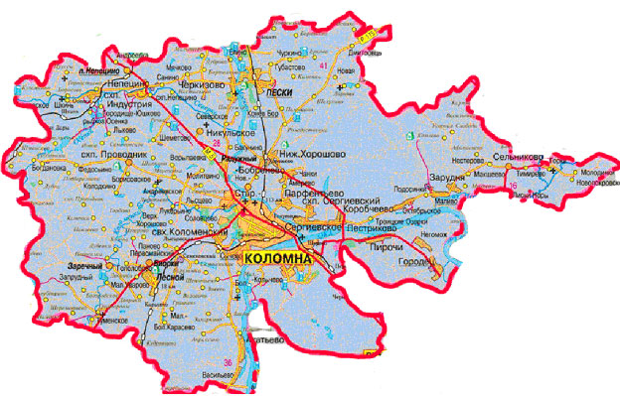
A local profile

Slide 2
Warm-up
Where are you from? – I am from ….
What town do you live in? – I live in ….
Is Kolomna a modern or an old town? – It’s ….
What is Kolomna famous for? – It’s famous for….
What is the weather like in winter/ in summer?-
It is hot/ warm/ cold/ cool/ windy/ cloudy/ sunny.

Slide 3
A local profile (описание местности)
profile – a short description that gives important details about a person, a group of people or a place.
A profile of the area includes main landmarks (объекты местности), roads, water supplies (водоёмы), etc.

Slide 4
Articles with geographical names Ex.2b p.52
Geographical names | the | zero article
continents |  | Europe
countries |  | Russia
cities/towns/villages |  | Vladivostok
regions | the Far East
mountains/ hills | the Urals
lakes |  | Baikal
oceans/seas | the Black Sea
rivers | the Lena

Slide 5
Task: add articles where necessary
the Arctic Ocean
the Baltic Sea
the Amur
the Caucasus
Magadan
the Yenisei
the Russian Federation
the Appalachian Mountains
the United Kingdom
England
the Netherlands
Australia
the Kuril Islands
the Volga

